Slide 1

Analysis of Airbnb Data Using Power BI
Prepared By
Pratik Datta
ABADS Batch 8A

Slide 2
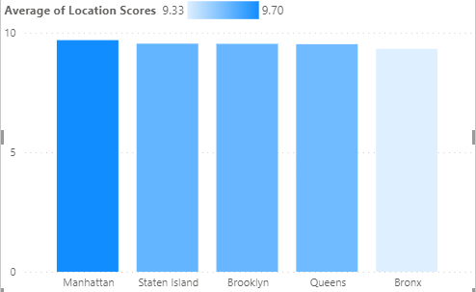
Assessing District Location Scores
As the column chart suggests, amongst the 5 districts of New York City, Manhattan has the highest of Average Location Scores
Subsequently, Bronx is the district which is having the lowest Location score in the New York City
The gap between the different districts regarding the average location score is very marginal.

Slide 3
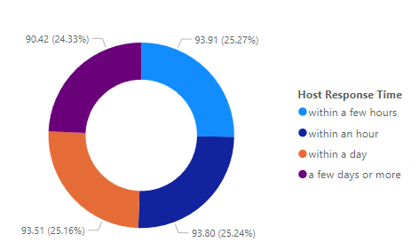
Examining Host Response Time Impact
As we can see from the donut chart, that the proportion of different time taken amongst the Host Response Time is very evenly distributed
But we can see that more the time user takes for responding the lesser the average overall rating of Airbnb listings.

Slide 4
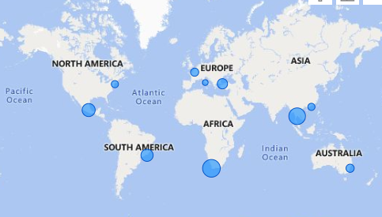
Visualizing Airbnb Listing Prices
Here the Global Map feature of the Power Bi Desktop is used to visualize the Airbnb listing price across different cities globally
We can see that Cape Town is having the highest Average Listing Prices and Rome on the other hand is having the lowest average City Price

Slide 5
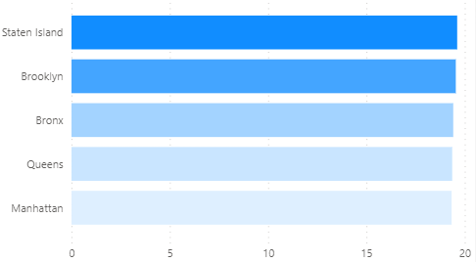
Analysing Composite Scores
Here by using the new column feature, the two columns of Host Communication and Check in Experience is added up to form the composite column
We can see that, Staten Island is having the highest composite score in New York City and Manhattan is having the lowest amongst the different districts

Slide 6
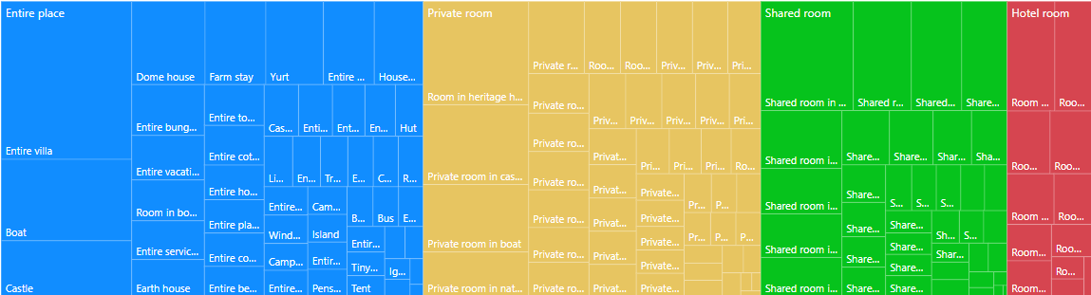
Property Type Price Analysis
Here by using a tree map feature we can see that Entire places with Entire Villa is having the Highest Average Price among the listings of Airbnb over the world

Slide 7
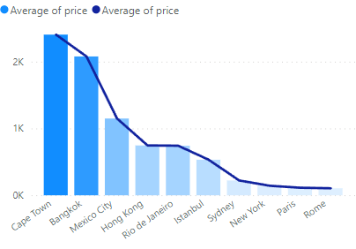
City wise price for listing
Although visualized earlier with the help of Map, Here the same city wise price is revisualized with the help of a combination of Line and Column chart
As we know, CapeTown is having the highest average price and Rome has the lowest amongst all the cities where Airbnb is having its listings

Slide 8
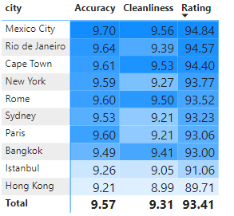
City wise scores
Here three parameters are taken into considerations, Accuracy Score, Cleanliness Score and Overall rating
Mexico City is having the highest accuracy score and cleanliness where as, Hongkong having the lowest
Subsequently we can also see that the rating is also reflecting in the similar direction as well.

Slide 9
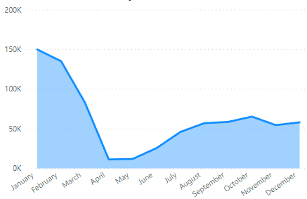
Monthly trend for visitors
As the trend is analyzed for the visiting number of people across the different months of the year with the help of combination of line and area
We can see that there is a sharp decline in the April may June time due to the summer seasons in most of the places.
We have specifically focused on the 2020 data for the particular case.

Slide 10
Thank you

